Slide 1


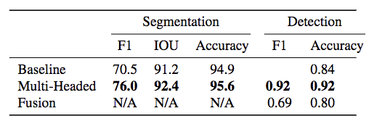
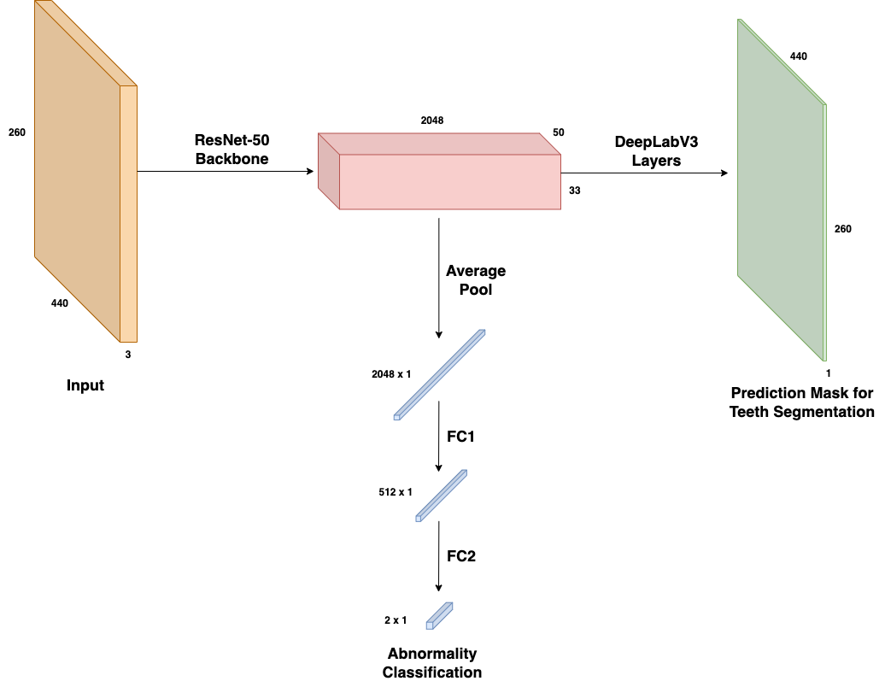
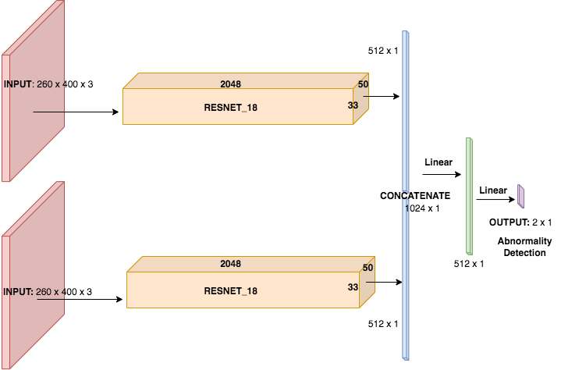
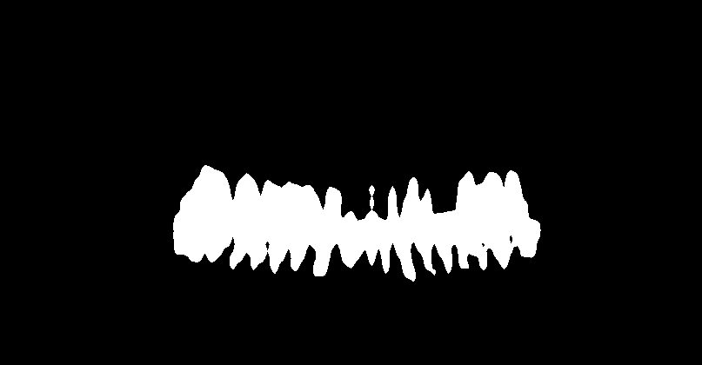

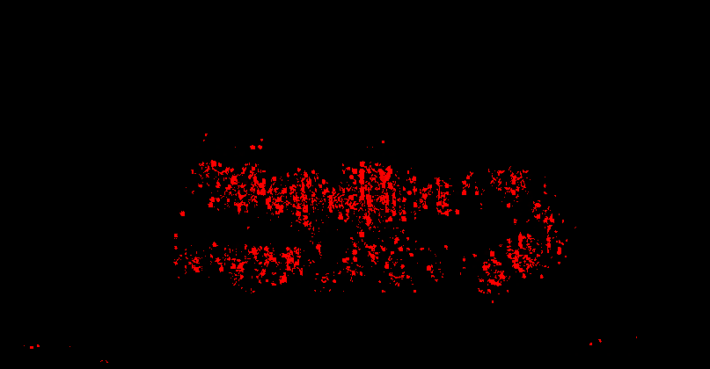
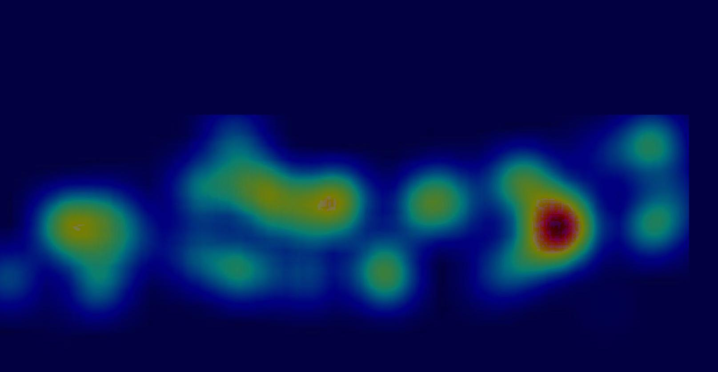
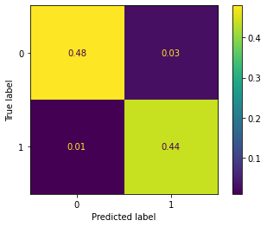
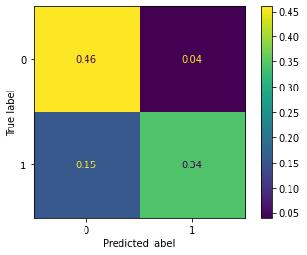
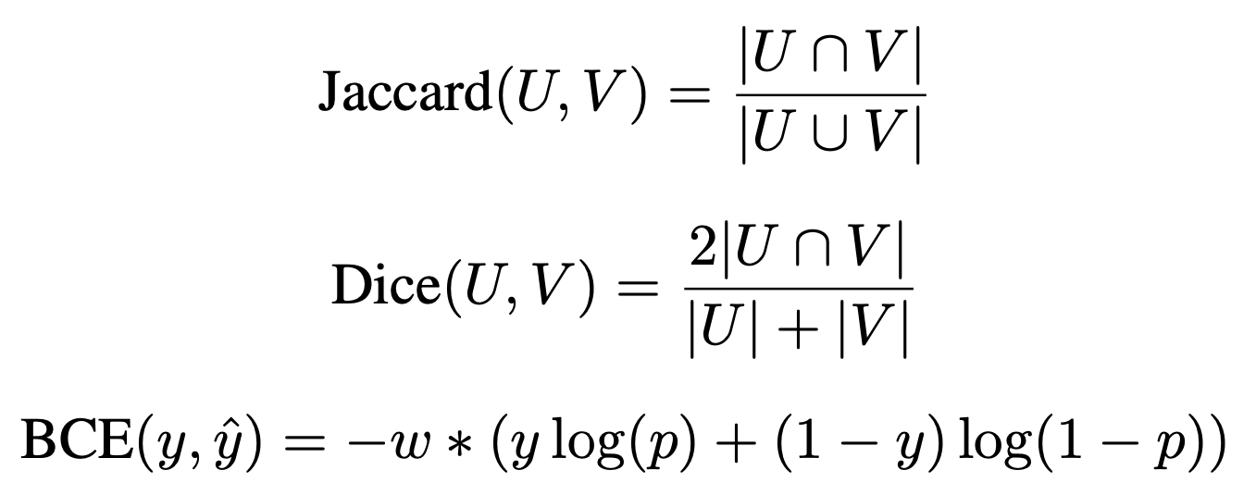
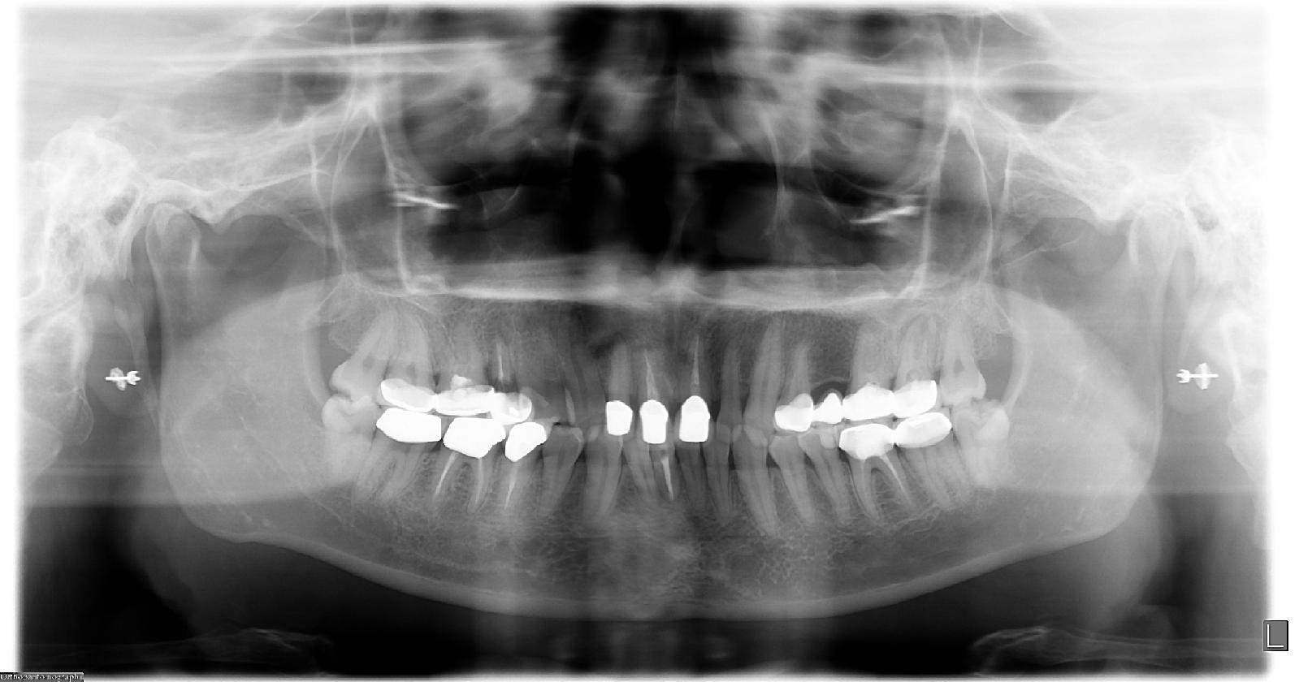
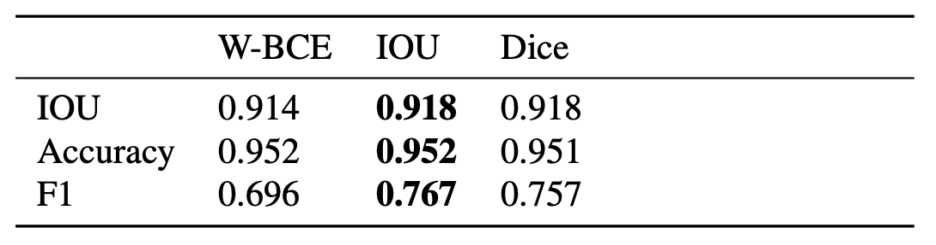
Multi-Objective Processing of Dental Panoramic Radiographs
Ting Lin,¹ Langston Nashold,¹ Poojan Pandya¹
¹Computer Science Department, Stanford University
Background
Methods
Results
Computer Science
Dentists diagnose based on panographic X-Rays
Time consuming and laborious process to count teeth and look for abnormalities
Can we use AI to automate it?
Model 1: Multi-Headed CNN Model
Model 2: Fusion CNN Model
Problem
Problem: Given a panographic radiograph, produce a semantic segmentation teeth mask and a binary label denoting if it has an abnormality
Approach: DeepLabv3 Spatial pooling pyramid, with fusion and multi-task labelling
Metrics: IOU, F1, Accuracy
Predicted Output
Ground Truth
ResNet50 backbone
Atrous Spatial Pooling Pyramid on top of backbone to predict teeth mask
FCN on backbone to do abnormality classification
Gaze map and radiograph are passed into two ResNet-18s
ResNet output is fused and passed through a two layer FCN to produce abnormality classification
Saliency Map
Gaze Plot
Data
Saliency map showing the pixel-wise gradient of each pixel in the input image
Illustrates the relative contribution of each pixel
Tufts Dental Dataset (April 2022)
Largest publicly available dental dataset
1000 panoramic dental radiographs with teeth mask, abnormality mask, and gaze map
Conclusion
Multi-headed Approach works best
Most large dental datasets aren’t public
Future Research
Exploring textual descriptions through Natural Language Processing
Vision Transformers
Self-Supervised Learning
MH Confusion Matrix
FS Confusion Matrix
Ablation performed on Jaccard, Dice, and BCE Loss
Radiograph

